Slide 1
Deep Belief Networks for Spam Filtering
Grigorios Tzortzis and Aristidis Likas
Department of Computer Science,
University of Ioannina, Greece

Slide 2
Outline
The spam phenomenon
What is spam
Spam filtering approaches
Deep belief networks for spam detection
Training of DBNs
Experimental evaluation
Datasets and preprocessing
Performance measures
Comparison to support vector machines (SVMs) (considered state-of-the-art)
Conclusions

Slide 3
What is Spam?
Unsolicited Bulk E-mail
In human terms: any e-mail you do not want
Large fraction of all e-mail sent
Radicati Group est. 62% of e-mail traffic in Europe is spam – 16 billion spam messages sent everyday
Still growing – to reach 38 billion by 2010
Best solution to date is spam filtering

Slide 4
Spam Filtering Approaches
Knowledge Engineering
Spam filters based on predefined and user-defined rules
Static rules – easily bypassed by spammers
Suffers from poor generalization
Machine Learning
Automatic construction of a classifier (training set)
Keeping the filter up-to-date is easy (retraining)
Higher generalization compared with rule-based filters

Slide 5
Machine Learning for Spam Detection
Numerous classification methods have been proposed
Naïve Bayes (already used in commercial filters)
Support Vector Machines (SVMs)
etc …
In this work we propose the use of a Deep Belief Network to tackle the spam problem

Slide 6
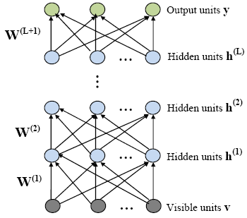
Deep Belief Networks (DBNs)
What is a DBN (for classification)?
A feedforward neural network with a deep architecture i.e. with many hidden layers
Consists of: visible (input) units, hidden units, output units (for classification, one for each class)
Higher levels provide abstractions of the input data
Parameters of a DBN
W^{(j)} :weights between the units of layers j-1 and j
b^{(j)} : biases of layer j (no biases in the input layer).

Slide 7
Training a DBN
Conventional approach: Gradient based optimization
Random initialization of weights and biases
Adjustment by backpropagation (using e.g. gradient descent) w.r.t. a training criterion (e.g. cross-entropy)
Optimization algorithms get stuck in poor solutions due to random initialization
Solution
Hinton et al [2006] proposed the use of a greedy layer-wise unsupervised algorithm for initialization of DBNs parameters
Initialization phase: initialize each layer by treating it as a Restricted Boltzmann Machine (RBM)
Recent work justifies its effectiveness (Hinton et al [2006], Bengio et al [2006])

Slide 8
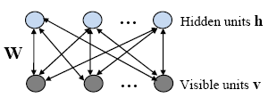
Restricted Boltzmann Machines (RBMs)
An RBM is a two layer neural network
Stochastic binary inputs (visible units) are connected to stochastic binary outputs (hidden units) using symmetrically weighted connections
Parameters of an RBM
W :weights between the two layers
b, c :biases for visible and hidden layers respectively
Layer-to-layer conditional distributions (for logistic units)
Bidirectional
Connections

Slide 9
RBM Training
For every training example (contrastive divergence)
Propagate it from visible to hidden units
Sample from the conditional
Propagate the sample in the opposite direction using ⇒ confabulation of the original data
Update the hidden units once more using the confabulation
Update the RBM parameters
Repeat
Sample
Sample
Remember that RBM training is unsupervised
Data vector v

Slide 10
DBN Training Revised
Apply the RBM method to every layer (excluding the last layer for classification tasks)
The inputs to the first layer RBM are the input examples
For higher layer RBMs feed the activations of hidden units of the previous RBM, when driven by data not confabulations, as input
W^{(L+1)} random
W^{(L)} ,b^{(L)}
W⁽²⁾ ,b⁽²⁾
W⁽¹⁾ ,b⁽¹⁾
Good initializations are obtained
Fine tune the whole network by backpropagation w.r.t. a supervised criterion (e.g. mean square error, cross-entropy)

Slide 11
Testing Corpora
3 widely used datasets
LingSpam SpamAssassin EnronSpam
Corpus | Messages | Spam Ratio | Message Format | Message Source
 |  |  |  | Ham | Spam
LingSpam | 2893 | 16.6% | Subject -Body | Linguist List | Creators’ Inbox
SpamAssassin | 6047 | 31.3% | Row | User Donations | User Donations
EnronSpam (Enron1) | 5172 | 29% | Subject -Body | Enron Employee | Creators’ Inbox

Slide 12
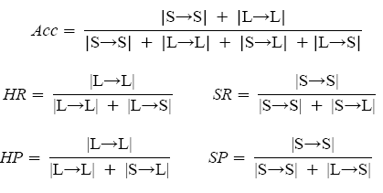
Performance Measures
Accuracy: percentage of correctly classified messages
Ham - Spam Recall: percentage of correctly classified ham – spam messages
Ham - Spam Precision: percentage of messages that are classified as ham – spam that are indeed ham - spam

Slide 13
Experimental Setup
Message representation: x=[x₁, x₂, …, x_{m}]
Each attribute corresponds to a distinct word from the corpus
Use of frequency attributes (occurrences of word in message)
Attribute selection
Stop words and words appearing in <2 messages were removed + Information gain (m=1000 for SpamAssassin m=1500 for LingSpam and EnronSpam)
All experiments were performed using 10-fold cross validation

Slide 14
Experimental Setup - continued
SVM configuration
Cosine kernel (the usual trend in text classification)
The cost parameter C must be determined a priori
Tried many values for C – kept the best
DBN configuration
Use of a m-50-50-200-2 DBN architecture (3 hidden layers) with softmax output units and logistic hidden units
RBM training was performed using binary vectors for message representation (leads to better performance)
Fine tuning by minimizing cross-entropy error (use of frequency vectors)

Slide 15
Experimental Results
Performance Measure | LingSpam
 | DBN 1500-50-50-200-2 | SVM C=1
Accuracy | 99.45% | 99.24%
Spam Recall | 98.54% | 96.67%
Spam Precision | 98.2% | 98.74%
Ham Recall | 99.63% | 99.75%
Ham Precision | 99.71% | 99.35%
Performance Measure | SpamAssassin
 | DBN 1000-50-50-200-2 | SVM C=10
Accuracy | 97.5% | 97.32%
Spam Recall | 95.51% | 95.24%
Spam Precision | 96.4% | 96.14%
Ham Recall | 98.39% | 98.24%
Ham Precision | 98.02% | 97.89%
Performance Measure | EnronSpam
 | DBN 1000-50-50-200-2 | SVM C=1
Accuracy | 97.43% | 96.92%
Spam Recall | 96.47% | 97.27%
Spam Precision | 94.94% | 92.74%
Ham Recall | 97.83% | 96.78%
Ham Precision | 98.53% | 98.84%

Slide 16
Experimental Results - continued
The DBN achieves higher accuracy on all datasets
Beats the SVM against all measures on SpamAssassin
The DBN proved robust to variations on the number of units of each layer (kept the same architecture in all experiments)
DBN training is much slower compared to SVM training
A very encouraging result provided that SVMs are considered state-of-the-art in spam filtering

Slide 17
Conclusions
The effectiveness of the initialization method was demonstrated in practice
DBNs constitute a new viable solution to e-mail filtering
The selection of the DBN architecture needs to be addressed in a more systematic way
Number of layers
Number of units in each layer

Slide 18
Thank you for listening
Any questions?

